Slide 1
Agenda
Docker Advanced Concepts
Networking Basics
IP Address
Subnet
Docker Networking
Container Orchestration
Docker Swarm
Docker Service
Docker Compose

Slide 2
IP Address
IP address is a series of four numbers separated by periods. Generally it looks like 147.181.183.86.
Each number will range from 0 to 255. So 255 would be the largest number in an ip address and 0 would be the smallest number.
Each number is an eight bit number and looks like:
  10010011.10110101.10110111.01010110 = 147.181.183.86
Notes:
https://portforward.com/networking/subnetting.htm

Slide 3
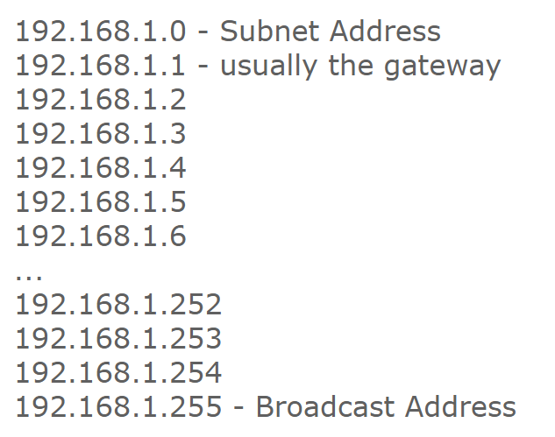
Subnet
Used to group IP addresses and looks a lot like an IP address. A typical subnet mask is 255.255.255.0.
These numbers range from 0 to 255.
Each number is an eight-bit number and looks like:
  11111111.11111111.11111111.00000000= 255.255.255.0
  Every group of IP addresses, has a Subnet Address, Broadcast Address, and Gateway.
  Both the Subnet and the Broadcast are used to send information to every IP address in the group. The Gateway acts sort of like the group's controller.
Notes:
https://portforward.com/networking/subnetting.htm
The gateway can be on any ip address in the range. Usually it is on the second ip address in the range, or the second ip address from the end of the range.
The Subnet Address is always on the first ip address in the range, and the Broadcast Address is always on the last one in the range.
https://en.wikipedia.org/wiki/Classless_Inter-Domain_Routing
For IPv4, CIDR notation is an alternative to the older system of representing networks by their starting address and the subnet mask, both written in dot-decimal notation. 192.168.100.0/24 is equivalent to 192.168.100.0/255.255.255.0.
The number of addresses of a subnet may be calculated as 2^{address length − prefix length}, where address length is 128 for IPv6 and 32 for IPv4. For example, in IPv4, the prefix length /29 gives: 2³² ⁻ ²⁹ = 2³ = 8 addresses.
https://www.geeksforgeeks.org/classless-inter-domain-routing-cidr/
https://www.geeksforgeeks.org/introduction-of-classful-ip-addressing/
https://www.calculator.net/ip-subnet-calculator.html
Class A network contains 2²⁴ Hosts,
Class B network contains 2¹⁶ Hosts,
Class C network contains 2⁸ Hosts

Slide 4
Docker Networking
Docker Networking
Bridge
Overlay
None
Host
Single Host
Multi Host
Notes:
https://geekylane.com/learn-docker-networking-theory/
https://success.docker.com/article/networking

Slide 5

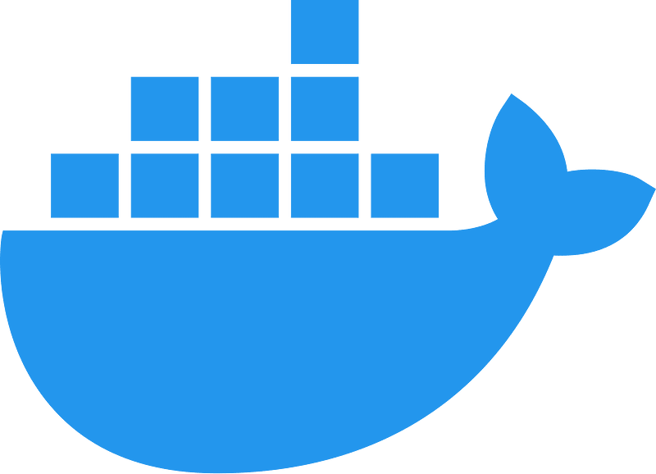
Docker Single Host Networking
docker run myapp
docker run myapp --network host
docker run myapp --network none
Bridge (Default)
5000
None
Web Container
Host
Web
Container
Web
Container
172.17.0.2
172.17.0.3
Docker0
172.17.0.1
Backend
Container
172.17.0.4
172.17.0.5
Web
Container
Database
Container
Notes:
Network None:
Reachable within the cluster
Connect front-end container to backend container

Slide 6
Bridge
Default driver
The bridge is a private network restricted to a single docker host
Each container is placed in its own network namespace
The bridge driver creates a bridge(virtual switch) on a single Docker host.
All containers on a bridge network can communicate with each others but containers on different bridge network cannot communicate with each other.
Offers external access to containers through the port mapping

Slide 7
Host
The Host Network Driver allows containers to use the host’s network stack directly.
Removes the network isolation between the docker host and the docker containers to use the hosts networking directly.
No two containers can use the same port(s).
Used to setup, one or only a few containers on a single host.

Slide 8
None
Completely disable the networking stack on a container.
By using this mode, it will not configure any IP for the container and have no access to the external network as well as for other containers.

Slide 9

Docker Multi Host Networking
Web
Container
Web
Container
API
Container
API
Container
Database
Container
Redis
Container
172.17.0.2
172.17.0.3
172.17.0.2
172.17.0.3
172.17.0.2
172.17.0.3
Docker0
172.17.0.1
Docker0
172.17.0.1
Docker0
172.17.0.1
Overlay Network (10.0.9.0)

Slide 10
Overlay
Manage communications among the Docker daemons participating in the swarm.
The overlay driver enables simple and secure multi-host networking.
All containers on the overlay network can communicate with each other.
Notes:
http://100daysofdevops.com/21-days-of-docker-day-11-docker-networking-part-3/2/

Slide 11
Docker Network Commands
> docker network --help
> docker network ls
> docker network create --driver bridge mybridge
> docker network inspect mybridge
> docker run --network mybridge --name=myapp imagename
> docker network connect mybridge myapp
> docker network disconnect mybridge myapp
> docker network rm mybridge
> docker inspect -f "{{range .NetworkSettings.Networks}}{{.IPAddress}}{{end}}" <container_id>
Notes:
docker run --network mybridge -e "ACCEPT_EULA=Y" -e "SA_PASSWORD=YourStrong@Passw0rd" -p 5030:1433 --name mysqlserver -d mcr.microsoft.com/mssql/server:2019-CU4-ubuntu-16.04

Slide 12
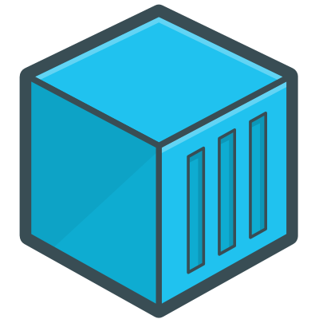
Docker Compose
Compose is a tool for defining and running multi-container applications with Docker.
With Compose, a multi-container application is defined using a single file and then spin your application up using a single command.
All of that can be done by Docker Compose in the scope of a single host.
The Docker Compose is useful for setting up development and testing workflows.
Compose
Notes:
For multi-host deployment, you should use more advanced solutions, like Apache Mesos or a complete Google Kubernetes architecture

Slide 13
version: '3.4'
networks:
docker_app:
driver: bridge
ipam:
driver: default
config:
- subnet: 172.16.238.0/24
services:
db:
image: "mcr.microsoft.com/mssql/server:2022-CU12-ubuntu-22.04"
environment:
ACCEPT_EULA: 'Y'
SA_PASSWORD: 'YourStrong@Passw0rd'
networks:
docker_app:
ipv4_address: 172.16.238.2
ports:
- "5020:1433"
aspnetdockercrud:
image: ${DOCKER_REGISTRY-}aspnetdockercrud
build:
context: .
dockerfile: ASPNetDockerCRUD/Dockerfile
container_name: 'aspnet_app'
networks:
docker_app:
ipv4_address: 172.16.238.3
ports:
- "5010:8080"
docker swarm init
// if swarm enabled then leave it
docker swarm leave --force
docker-compose -f docker-compose.yml up -d
docker-compose -f docker-compose.yml down
docker-compose -f docker-compose.yml start
docker-compose -f docker-compose.yml stop
Notes:
http://dockerlabs.collabnix.com/docker/cheatsheet/
IPAM:(IP Address Management) is the administration of DNS and DHCP, which are the network services that assign and resolve IP addresses to machines in a TCP/IP network. Simply put, IPAM is a means of planning, tracking, and managing the Internet Protocol address space used in a network.
version: '3.4'
networks:
docker_app:
driver: bridge
ipam:
driver: default
config:
- subnet: 172.16.238.0/24
services:
db:
image: "mcr.microsoft.com/mssql/server:2019-CU4-ubuntu-16.04"
environment:
ACCEPT_EULA: 'Y'
SA_PASSWORD: 'YourStrong@Passw0rd'
container_name: 'sql_db'
networks:
docker_app:
ipv4_address: 172.16.238.2
ports:
- "5020:1433"
aspnetdockercrud:
image: ${DOCKER_REGISTRY-}aspnetdockercrud
build:
context: .
dockerfile: ASPNetDockerCRUD/Dockerfile
container_name: 'aspnet_app'
networks:
docker_app:
ipv4_address: 172.16.238.3
ports:
- "5010:80"

Slide 14
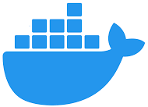
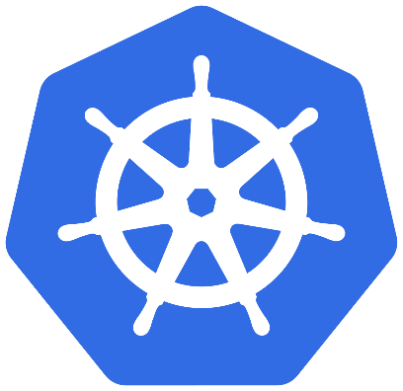

Container Orchestration
Docker Swarm
Kubernetes
MESOS

Slide 15
Docker Swarm
Swarm is a cluster of Docker hosts that are called nodes.
Docker Swarm is a native clustering tool for Docker that can turn a pool of Docker hosts into a single virtual host.
The swarm cluster consists of a swarm manager and a set of workers.
With swarm, you can deploy and scale your applications to multiple hosts.
Swarm helps in containers management, scaling, service discovery, and load balancing between the nodes in the cluster.
Notes:
https://www.callicoder.com/docker-machine-swarm-stack-golang-example/

Slide 16
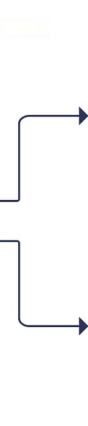
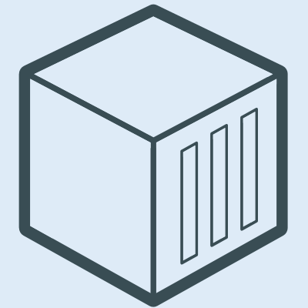
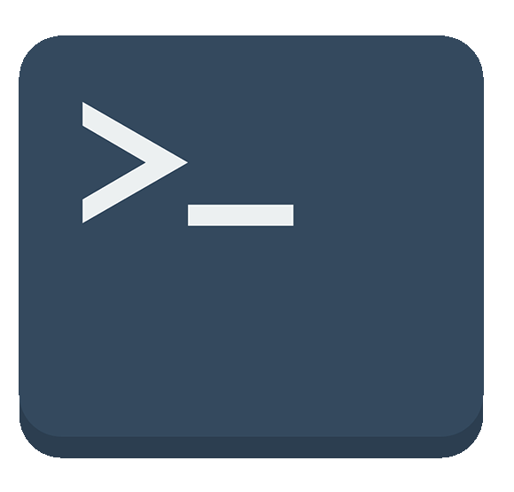
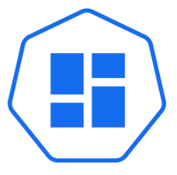
Docker Swarm Architecture
Worker Node1
Service
Task
Task
Manager Node
API
Docker CLI
Daemon
Orchestrator
Scheduler
Worker Node2
Dispatcher
Service
Task
Task
UI
Daemon

Slide 17
Docker Swarm Architecture Contd..
Manager nodes are used to perform control orchestration, cluster management and task distribution.
  API - Accepts commands from CLI and create service object
  Orchestrator - Reconciliation loop for service objects and create tasks
  Scheduler - Assign Nodes to tasks
  Dispatcher - Checks in on workers
Worker nodes are used for running containers whose tasks are assigned by Manager nodes. Each node can be configured as a Manager node, Worker node, or as both.
Tasks - A task is a slot in which a single container is running. Tasks are the part of a Swarm service.
Service is one or more containers with the same configuration running under docker's swarm mode.

Slide 18
Docker Service
A docker "service" is one or more containers with the same configuration running under docker's swarm mode.
Manage a group of containers from the same image.
You can scale them (start multiple containers).
Docker service is useful for a microservices based application
docker build -t myapp . -f aspnetapp/Dockerfile
docker swarm init
docker service create --publish 8080:80 --name myapp myapp:v1
docker service rm myapp
docker service scale myapp=3

Slide 19
Docker Container vs. Docker Service
"docker run" command create a single independent container which is not a part of any orchestration such as docker swarm.
Not scalable to share the excessive load.
Containers running through Docker run will be of different configuration, such as Network adapters etc.
High availability is less as compared to the Cluster.
Simple networking to communicate between multiple containers.
Don't support auto recovery in case of failure.
"docker service create" command creates a service which is a part of a orchestration such as docker swarm or Kubernetes.
Supports scaling & load balancer to manage workloads.
Containers running through the Docker swarm will be of the same configuration.
For service, there is a master node and another are worker nodes to supports high availability.
Docker swarm uses mesh networking to communicate within the cluster.
Docker Swarm can auto recover the tasks in case of failure.

Slide 20
Docker Stack
Used to define and run multiple containers on a swarm cluster.
Docker stack ignore “build” instructions. You can’t build new images using the stack commands.
Needs pre-built images to deploy.
docker build -t dockerapp:v1 . -f ./myapp/Dockerfile
docker swarm init
docker stack deploy -c my-stack.yaml mystack
docker stack ls
docker stack rm mystack
docker stack services mystack
docker service scale mystack_appservice=3
Notes:
https://docs.docker.com/compose/compose-file/#deploy
version: '3.4'
networks:
docker_app:
driver: overlay
ipam:
driver: default
config:
- subnet: 172.16.238.0/24
services:
db:
image: "mcr.microsoft.com/mssql/server:2019-CU15-ubuntu-20.04"
environment:
ACCEPT_EULA: 'Y'
SA_PASSWORD: 'YourStrong@Passw0rd'
networks:
docker_app:
ipv4_address: 172.16.238.2
ports:
- "5020:1433"
aspnetdockercrud:
image: ${DOCKER_REGISTRY-}aspnet:v1
networks:
docker_app:
ipv4_address: 172.16.238.3
ports:
- "5010:80"

Slide 21
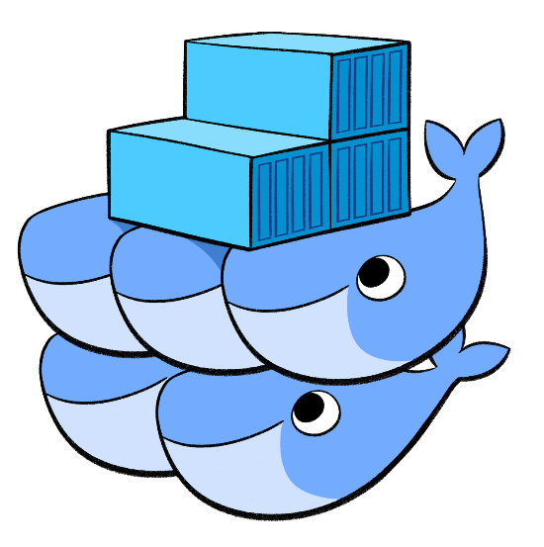
Docker Stack with Swarm
Docker CLI
compose.yml
Docker Swarm

Slide 22
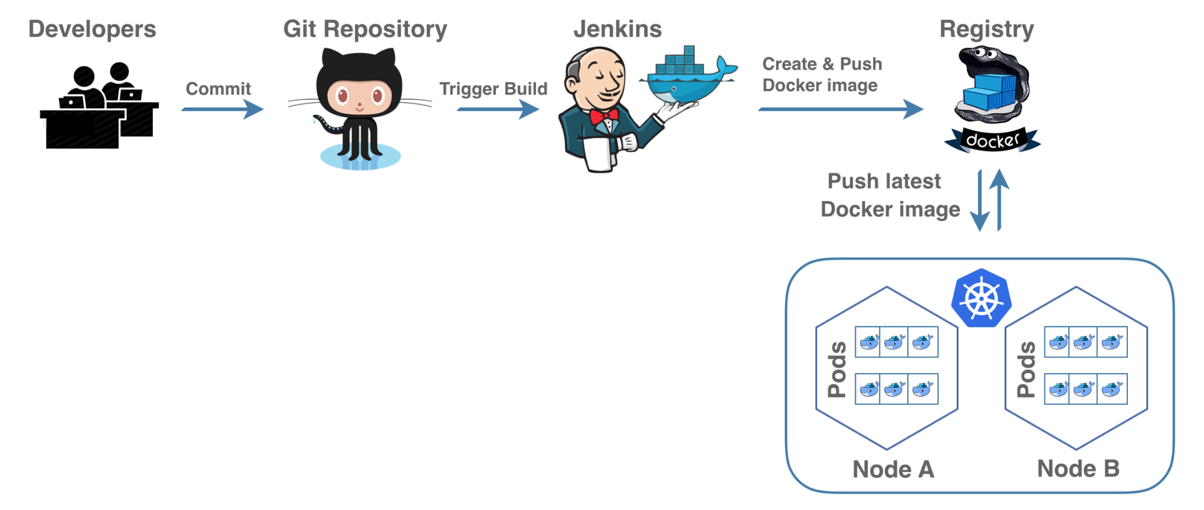
CI/CD Pipeline

